Slide 1
AME20216 - Lab I A1 - Metersticks

Slide 2
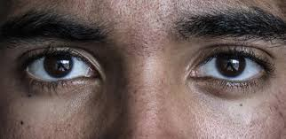
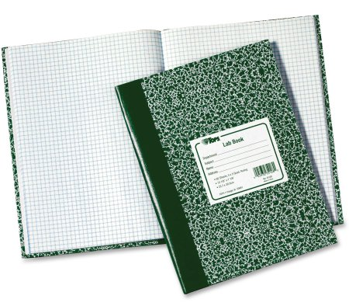
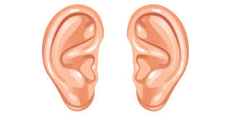
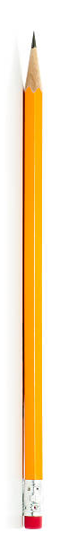
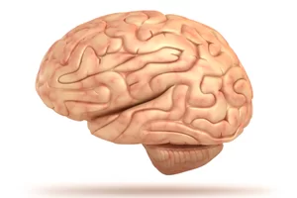
Stay engaged. Take notes in lecture.

Slide 3
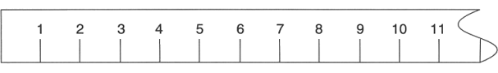
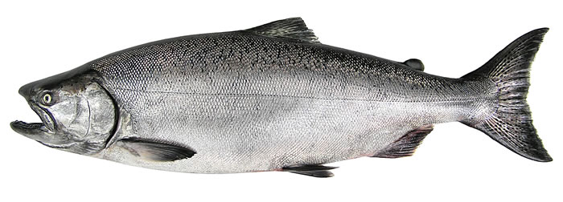
A1 – Meter Stick Measurements
The meter stick is one of the most basic scientific instruments.
cm
L = 9.4 ± 0.5 cm

Slide 4
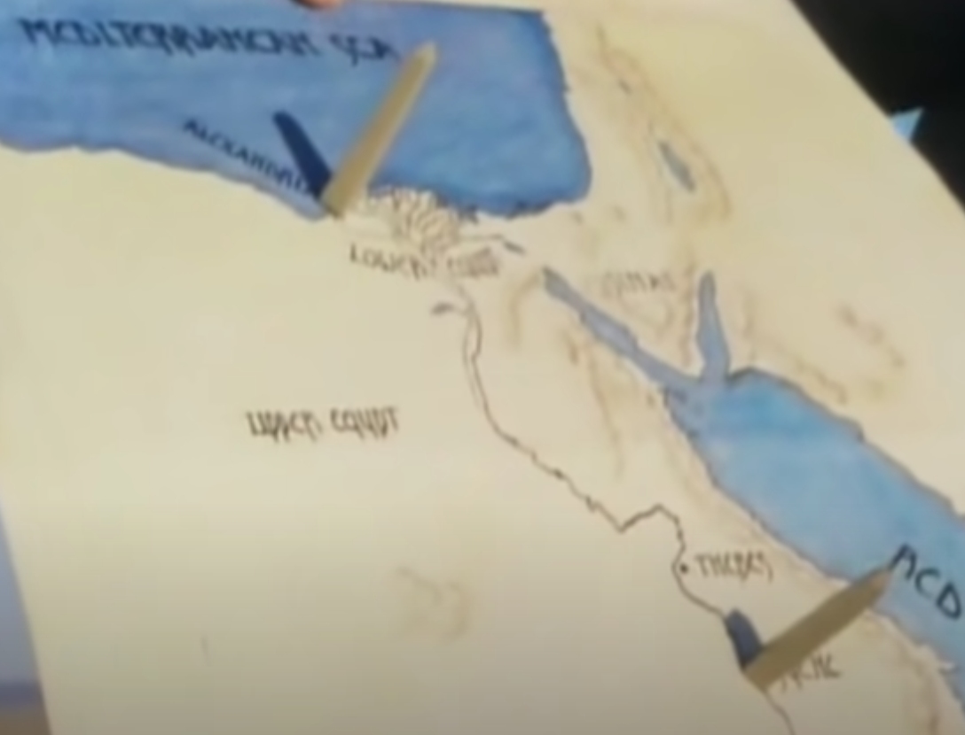
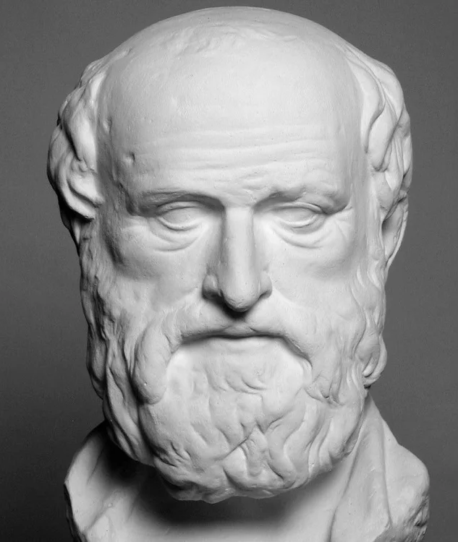
A1 – Meterstick Measurements
Using simple geometry, Eratosthenes measured the radius of the earth (c. 250 BC).
https://en.wikipedia.org/wiki/Eratosthenes
https://www.youtube.com/watch?v=G8cbIWMv0rI

Slide 5
Eratosthanes

Slide 6
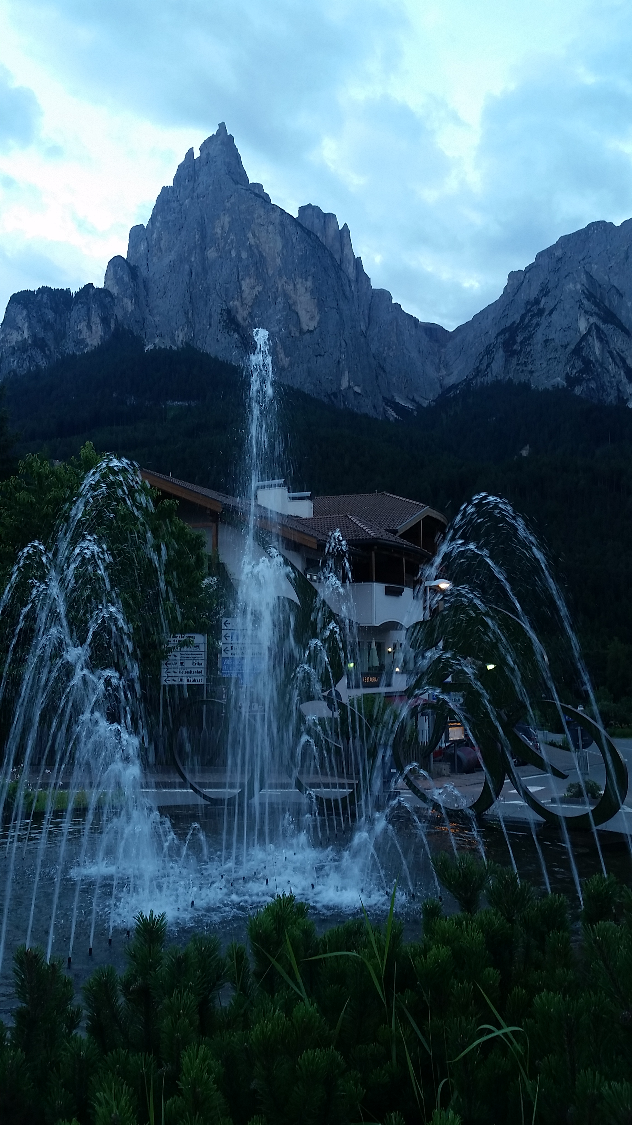
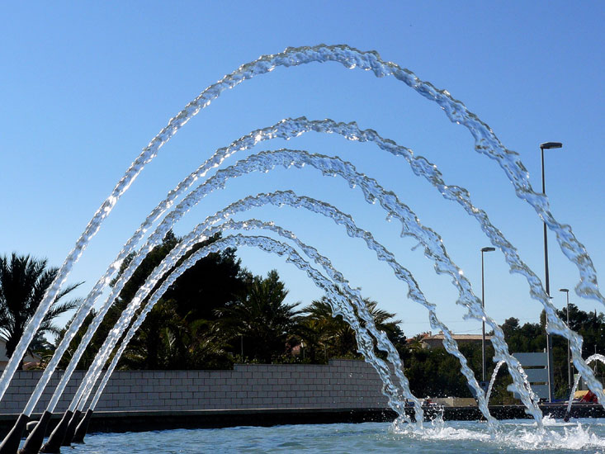
A1 – Meterstick Measurements
Meter sticks can be used in unexpected ways…
fluid velocity and pressure

